Slide 1

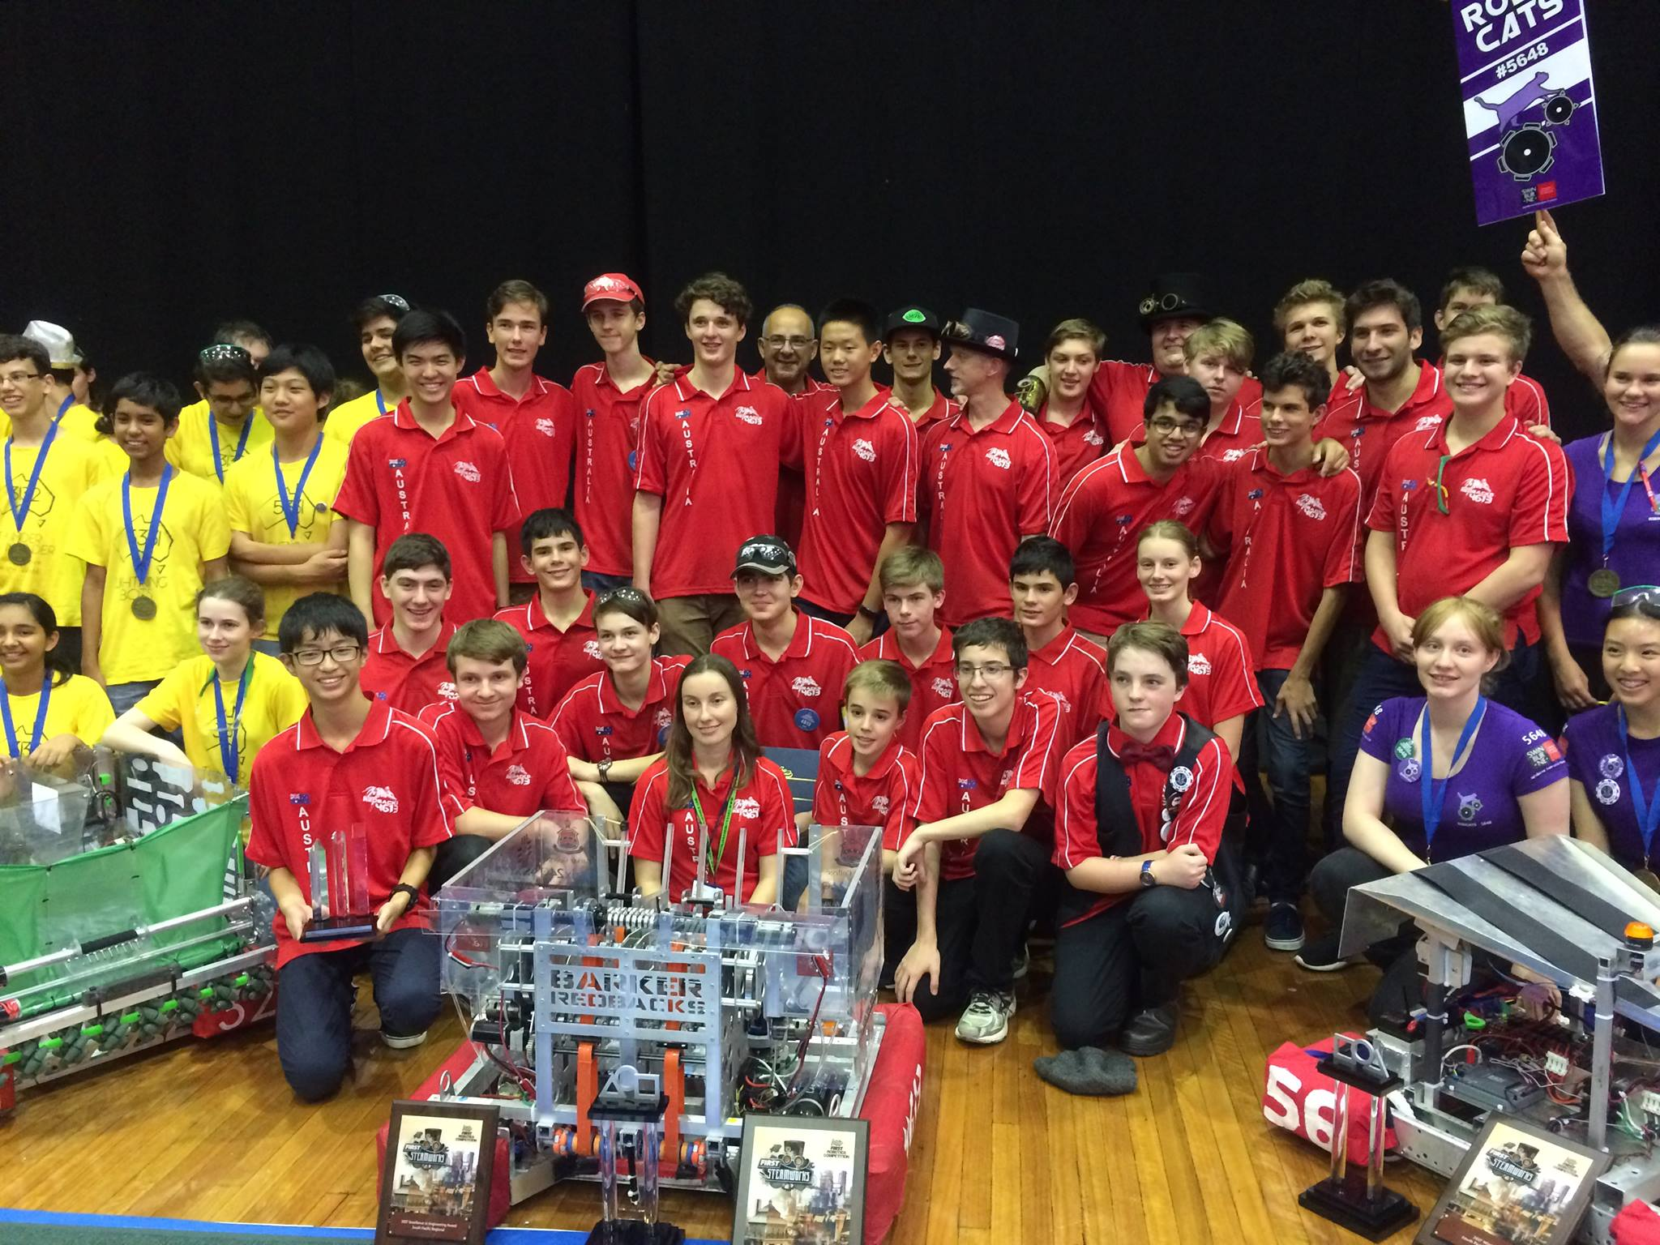
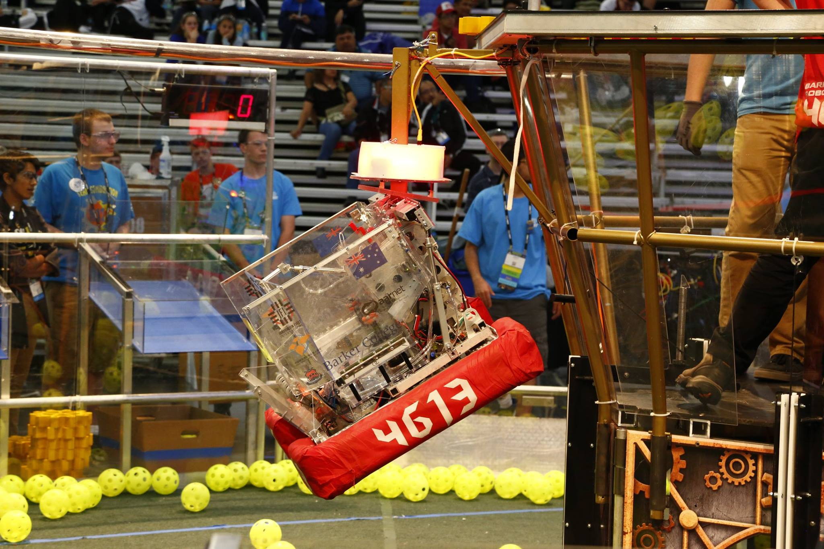
Introduction to (Java) Programming 12 – Other Java Concepts
Matthew Brian

Slide 2
Lesson 12: Other Java Concepts
Arrays
Imagine I have a hotel with ten rooms inside it and want to track the number of guests that are residing within each individual room
Many of you will think to declare ten different variables to track the number of guests in each room
But now that we look at it much more closely, we can see that this seems rather inefficient, both in its declaration, and by the fact that you have to reference each variable on a separate line to interact with them
This way might now seem very clunky to you now. Surely a better way exists, right?
int guestsInRoomNum0, guestsInRoomNum1, guestsInRoomNum2, guestsInRoomNum3, guestsInRoomNum4, guestsInRoomNum5, guestsInRoomNum6 . .
Analogy inspired by “Java for Dummies 6th Edition”

Slide 3
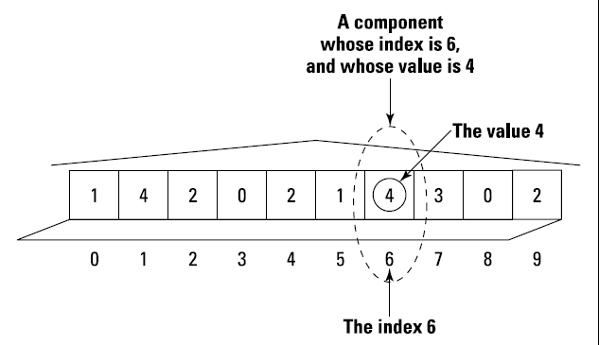
Lesson 12: Other Java Concepts
This better way is known as an array, which some of you may know from your time programming in python to be lists
An array is a row of values, like each room in order in our motel.
The entire row of rooms you can see to the right is called an array
Each room in the array is called a component of the array, and each component has an element associated with it (In this case, the number of residents in each room)
You can create an array like this, but this limits the size of the array, and isn’t as flexible as we would like it to be
int guests[] = new int[10];
guests[6] = 4
Analogy inspired by “Java for Dummies 6th Edition”

Slide 4
Lesson 12: Other Java Concepts
Such arrays are much more flexible, as they allows us to iterate through each array component and so something to it
But, we want to be able to change the size of our arrays at will right?
Enter the Java ArrayList, an object that can store any amount of anything for you!
In lists, you can only store ONE type of something
Hopefully I will now explain to you what each part of this ArrayList means, and the significance that comes with it being an object
for (int roomNum = 0; roomNum < 10; roomNum++) {
guests[roomNum] = 2;
}
ArrayList<InsertObject> rooms = new ArrayList<>();
Analogy inspired by “Java for Dummies 6th Edition”

Slide 5
Lesson 12: Other Java Concepts
for (int roomNum = 0; roomNum < 10; roomNum++) {
guests.add(roomNum);
}
for (int roomNum = 0; roomNum < 10; roomNum++) {
System.out.println(guests.get(roomNum));
}
Array/List questions…

Slide 6
Lesson 12: Other Java Concepts
Access Modifiers
We have before seen these things like public and private
These are called Access modifiers, and they determine what can see what within a Java program
In Java, the words public, protected and private are access modifiers, and they change what parts of a Java program can see other parts
Fields and methods without access modifiers in their declarations are said to have default access
If something is public, everything within your java project can ‘see’ that member
If something is protected it can only be referenced by its children
If something is private it cannot be seen by anything outside of that class
If something has default access, it can only be accessed by other classes within the same package
Why might you want to restrict who can see what? What if you have a piece of banking software, you don’t want each account to be able to reference another. If you have questions, ask them now

Slide 7
Lesson 12: Other Java Concepts
Primitive types
Java has exactly eight primitive types (byte, short, int, long, float, double, char and boolean)
A char stores a singular character (To make a char, you surround it with single quotes – ‘B’)
A boolean stores a true or false value
int and double are numbers (Integers, and floating point decimal numbers respectively)
What happens when you throw a bunch of these together, say in a class to make a Chair? You get a more complicated type called a reference type
Primitive data types can be viewed as the molecules of programming in Java, and reference types are just compounds of these types
In other words, everything in java, in some way or another, is made up of primitive types

Slide 8

Lesson 12: Other Java Concepts
Activities
Create an ArrayList filled with Chair objects from the first OOP workshop (If you can’t do this, just add a bunch of Integers). Use a for loop to add them to the ArrayList
Use another for loop to go over every chair in the list and do something with each of them, like print out one of its fields, or call a method on it like move()
Make a few classes in a different package, and experiment quickly with accessing members in another package that have different access modifiers

